Slide 1
OBJECT ORIENTED CONCEPTS
By-Ms.Aquilla Afonso
Asst.Professor,St.Xavier’s College,Mapusa-Goa

Slide 2
objectives
To learn & understand the difference between Procedure Oriented and Object Oriented Programming Languages
To learn & understand the basic Concepts of Object Oriented Programming Language

Slide 3
UNIT 1
Introduction to Object Oriented Programming

Slide 4

What is POP?

Slide 5
Disadvantages of POP
No security of data
No code reusability and hence time for development and testing increases
Poor memory management
As the length of the application increases it causes slow performance
Code maintenance and enhancement are difficult
Unit 1:Introduction to Object Oriented Programming

Slide 6
Introduction to Object Oriented Programming
Object oriented programming is based on the
concepts of objects.
“Objects” are data structures that contain data
and functions
Unit 1:Introduction to Object Oriented Programming

Slide 7
Features of object oriented programming
Emphasis is on data rather than functions
Programs are divided into objects
Data is hidden and cannot be accessed by external functions
Objects communicate with one another through functions
New functions and data can be added easily
Functions that operate on the data of an object are tied together in the data structure.
Unit 1:Introduction to Object Oriented Programming

Slide 8
Basic concepts of object oriented programming
Objects
Classes
Data abstraction and encapsulation
Polymorphism
Inheritance
Dynamic binding
Message communication

Slide 9
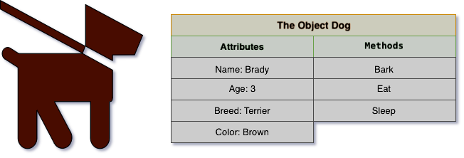
Objects – are basic runtime entities in an object oriented
system.They may represent a person,place,bank account.
Objects contain data and code to manipulate the data.
example:

Slide 10
class
Class- the entire set of data and code of an object can be
made a user-defined data type using the concept of a class.
Once a class has been defined ,any number of objects
belonging to that class can be created.
A class is a collection of objects of a similar type.

Slide 11
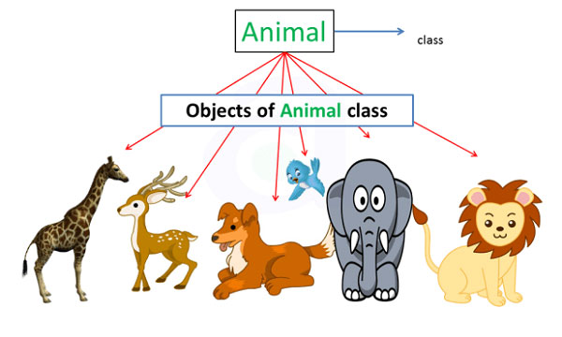
class

Slide 12
Data abstraction
Data abstraction refers to the act of representing essential
features without including the background details.
Example: A class birds can have a list of attributes like size,
weight ,feathers with methods to operate on the attributes.

Slide 13
Data Abstraction
Attributes
lays eggs
-feather
Bird
Attributes
Attributes
Non- Flying Birds
Flying Birds
parrot
crow
kiwi
penguin

Slide 14
Encapsulation
The wrapping up of data and methods into a single unit
(called class) is known as ‘encapsulation’.
The data is not accessible to the outside world and only the
methods wrapped in the class, can access it.
The insulation of data from direct access by the program is
called ‘data hiding’.

Slide 15
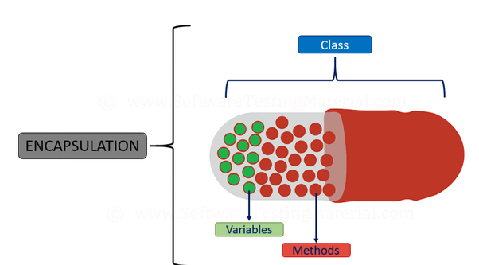

Slide 16
inheritance
Is the process by which objects of one class acquire the properties of objects of another class.
Inheritance supports the concept of hierarchical classification. For example , the bird parrot belongs to the
class flying bird, which is again a part of the class bird.
Inheritance provides the feature of reusability. This means we can add additional features to an existing class without
modifying it. The new class will have combined features of both the classes.

Slide 17
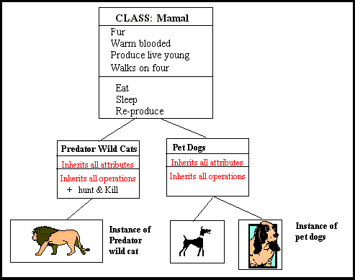
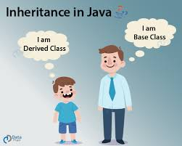
inheritance

Slide 18
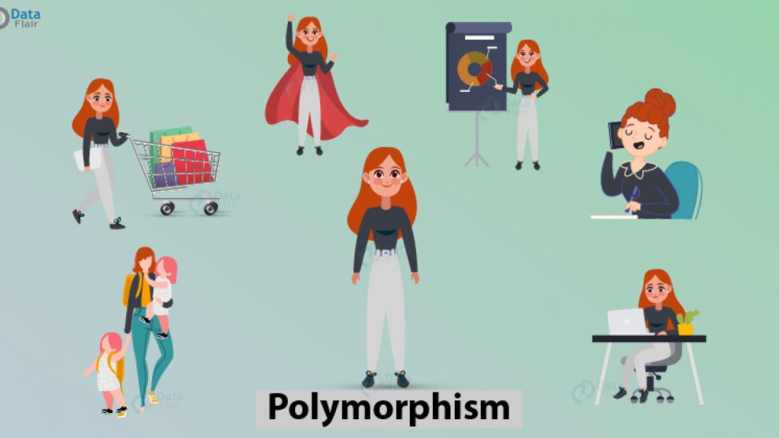
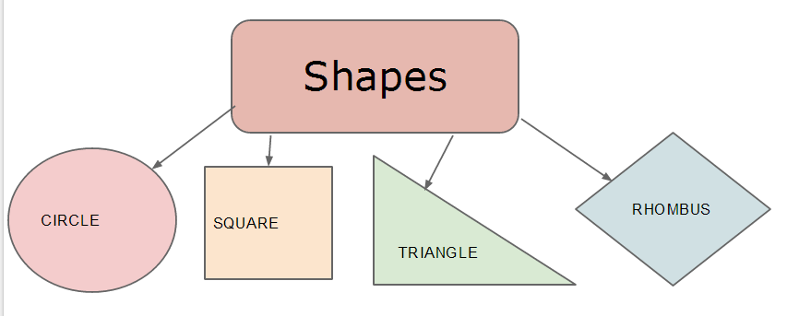
polymorphism
Means the ability to take more than one form.
Example : consider the operation of addition. For two numbers, the operation will generate a sum.

Slide 19
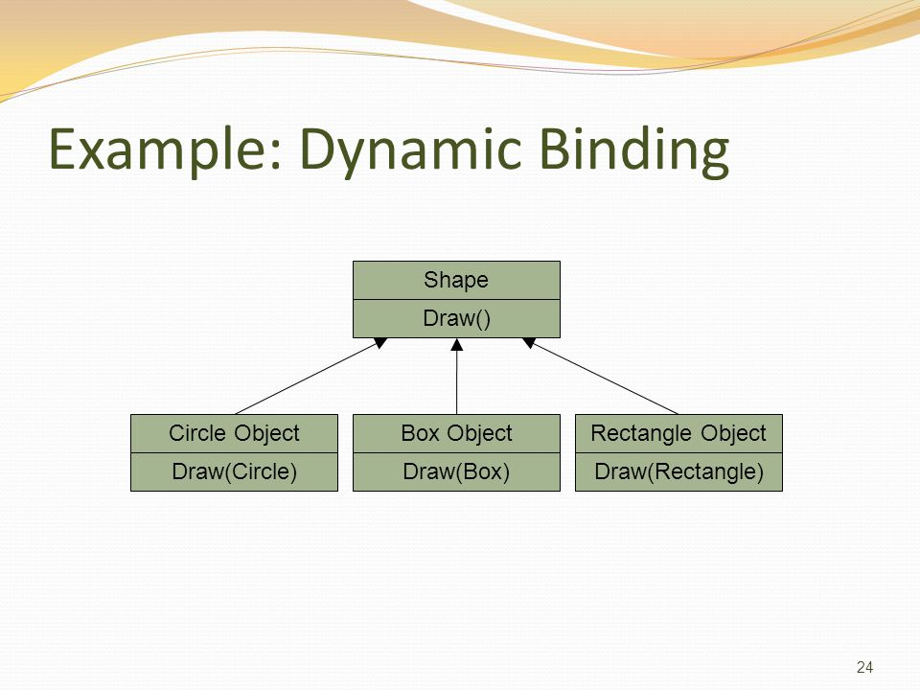
Dynamic Binding
Means that the code associated with a given procedural call
is not known until the time of the call at runtime.

Slide 20
Message communication
Objects communicate with one another by sending and
receiving information.
Message passing involves specifying the name of the
object, the name of the method and the information to be
sent.
Objects have a life cycle. They can be created and
destroyed.

Slide 21
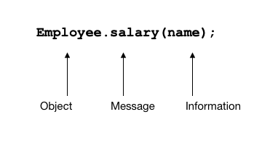
Message communication
Message passing specifies the name of the object, the name of the method and the information to be sent.
Here employee is an Object ,salary is the message and name is the parameter that contains the information.

Slide 22
Benefits of Object oriented programming
Through inheritance, we can eliminate redundant code
and extend use of existing classes.
Data hiding helps to build secure programs
Multiple objects can coexist without interference
Object oriented systems can be easily upgraded from small to
large systems.

Slide 23
Applications of OOP
Real-time systems
Object oriented databases
Artificial intelligence and expert systems
CAD systems

Slide 24
THANK YOU !!!!!!!!!!!

